Slide 1
Leveraging Deep Learning and Large Language Models to Identify Clinical Exposure Changes Due to Extrinsic and Intrinsic Factors
Hamed Meshkin
DARS Division Meeting
April 10, 2025

Slide 2
Outline
Prior Study (Fine-tuning LLM to extract clin pharm information with custom training dataset)
Objective
Background and Motivation (Extracting drug-drug Interaction + object and precipitant drug)
BioBert Directional DDI model
Result and Performance
Second Study (Directly Using LLM to extract clin pharm information with Few/zero training)
Objective
Background (Extracting drug-drug Interaction + patients' intrinsic factors)
LLM In-context learning (Few and Zero-shot learning)
Model Evaluation
Summary

Slide 3
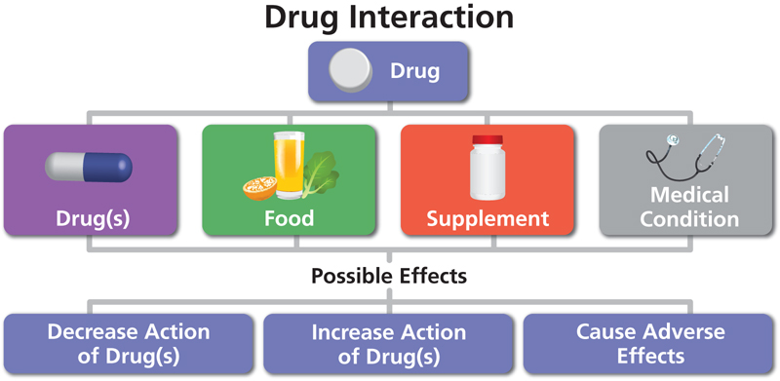
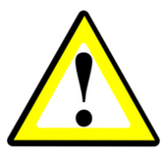
1. Goal (prior): Fine-tuning LLM to extract clin pharm information using custom dataset
Extract critical biomedical data, including pharmacokinetic drug-drug interactions, object and precipitant drugs, from literature.
Automatically Extract directional drug–drug interaction (DDI) from the natural text to identify the change in one drug’s clinical exposure due to the pharmacokinetic DDI of other drugs
Task 1
Task 2
“The mean values of Cmax and AUC of nifedipine are increased by 64% and 79%, respectively, by co-administration of propranolol [1]
Object?
propranolol is precipitant and nifedipine is the object drug
“Verapamil therapy may increase serum levels of cyclosporine.” [1]
Verapamil is precipitant and Cyclosporine is the object drug
Precipitant?
[1] https://dailymed.nlm.nih.gov/dailymed/fda

Slide 4
Introduction (prior)
Two-Step NLP Pipeline for Pharmacokinetic DDIs
Natural language processing (NLP) methods to automatically extract and process information from biomedical literature
Task 1: RE
Relationship Extract (RE)
NLP Model to identify PK DDI sentences
Pharmacokinetic drug-drug interaction sentences (PK-DDI)
Biomedical literature corpus
PK DDI
No Pharmacokinetic drug-drug interaction sentences (Non PK-DDI)
Task 2: NER
Name Entry Recognition (NER)
NLP Model to identify Precipitant and object drugs
Pharmacokinetic drug-drug interaction sentences (PK-DDI)
Precipitant drug
Object drug
1) Traditional Neural Network models
2) Pre-trained large Language models

Slide 5
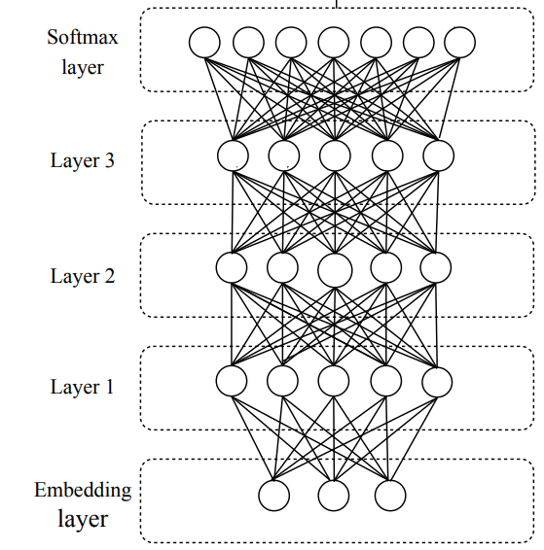
Background
Traditional NLP vs Pre-trained Language Models
1) Traditional Neural Network Models
Disadvantages
Training is slow and computationally expensive.
Long sequences cause vanishing gradients, leading to loss of word relationships
Fine-tune an LLM model
Pre-trained models drastically reduce training time.
Identify relationships between the elements using Attention Mechanism
Advantages
2) Pre-trained large language model
In-context learning
(Zero or few-shot learning)

Slide 6
1. Methodology (Prior) BioBert Fine-tuning Models
BioBERT = Pre-trained BERT + Additional pre-training on biomedical data
BioBert model pre-trained with PubMed
Bert
325 structured product tables
(Pre-specified by TAC2019)
PubMed abstracts
PMC full-text articles
21593 annotated sentences
Fine-Tuning
Model Training
13B words
BioBert Directional DDI model¹
BioBert 340M parameters
81 structured Product labels
(Pre-specified by TAC2019)
10592 unannotated sentences
Predict precipitant and object drugs in pharmacokinetic DDIs
Model Validation
Relationship Extract (RE)
Named Entry Recognition (NER)
QA
Evaluate Performance
Zirkle, Joel, et al. "Deep learning-enabled natural language processing to identify directional pharmacokinetic drug–drug interactions." BMC bioinformatics 24.1 (2023): 413.

Slide 7
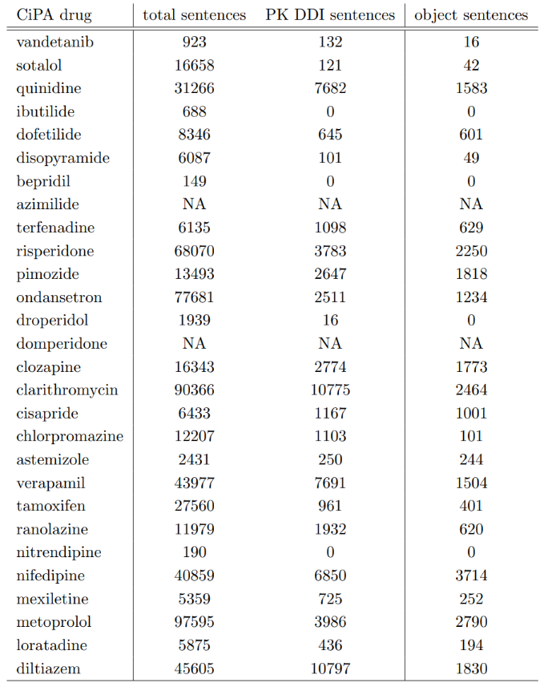
Result (Prior)
BioBert Directional DDI Model (fine-tuned BioBERT)
1st task: PK-DDI Identification Task
Real world problem
From a list of 28 drugs from the Comprehensive in vitro Proarrhythmia Assay (CiPA) Initiative.
Recall | 80.6 %
Precision | 82.7%
F-score | 81.6%
Performance of the sentence classification step.
2nd task: Identifying Object and Precipitant drugs in PK DDI sentences
 | Object | Precipitant
Recall | 93.7% | 94.6%
Precision | 100% | 100%
F-score | 96.8% | 97.2%
Performance of the named entity recognition step
Zirkle, Joel, et al. "Deep learning-enabled natural language processing to identify directional pharmacokinetic drug–drug interactions." BMC bioinformatics 24.1 (2023): 413.

Slide 8
2. Second study
Using LLM to extract clin pharm information with few/zero
Objective: Fine-tuning a pre-trained model for a new task is impossible unless we acquire an annotated dataset containing positive and negative examples related to the specific task.
Goal:
Extract critical biomedical data, such as pharmacokinetic drug-drug interactions, precipitant -object drug, and intrinsic factors and so on, from literature using locally hosted Large Language Models (LLMs).
Ensure data privacy to Implement secure locally hosted Large Language Models.

Slide 9


2. In-context learning
Few/Zero shot training
Few Shot Learning
Large data collection
Example 1: PK DDI sentence Example 2: PK DDI sentence
Example 3: Non-PK DDI sentence Example 4: Non-PK DDI sentence
+
Prompt + (sentences set)
FSL input
Query set Prediction
Pre-processing
Model Inference
Tokenization
Post-Processing
Few-shot learning (FSL) practice of feeding a machine learning model with a very small amount of training data to guide its predictions

Slide 10
2. In-context learning
Zero/Few shot training
Large data collection
Zero Shot Learning
Prompt + (sentences set)
ZSL input
Query set Prediction
Pre-processing
Model Inference
Tokenization
Post-Processing
Zero-shot learning (ZSL) is a Machine Learning paradigm that introduces the idea of Query samples with class labels that were never observed during the initial training phase

Slide 11

2. Comparison
Pre-trained Large Language Transformer Models
Model | Parameter size
DeepSeek | 32B
Flan-T5-XXL | 11B
Tk-Instruct | 11B
T0pp | 11B
Vicuna | 13.7B
ChatGPT3 | 175B
BioBERT | 0.34B
DeepSeek (Qwen)
Flan-T5-XXL
Tk-instruct
T0PP
Vicuna
BioBert
Large language transformer Models
Hugging Face

Slide 12
2. Prompt
Pharmacokinetic Drug-Drug Interaction
Model | Task 1: Identifying PK DDI sentences
Deep Seek | Is it true that this sentence relates to how the pharmacokinetics of one drug, namely absorption, distribution, metabolism, or excretion, change when co-administered with another drug, indicating a pharmacokinetic drug-drug interaction? “The co-administration of AFINITOR with long-acting octreotide increased octreotide C_{min} by approximately 50%.” Exclusively answer with Yes or No
Flan-T5 | Is it true that this sentence relates to how the pharmacokinetics of one drug, namely absorption, distribution, metabolism, or excretion, change when co-administered with another drug, indicating a pharmacokinetic drug-drug interaction? “The co-administration of AFINITOR with long-acting octreotide increased octreotide C_{min} by approximately 50%.” Options: -Yes -No
Tk-instruct | In this task, you are given two sentences. Indicate if the first sentence clearly entails the second sentence (i.e., one can conclude the 2nd sentence by reading the 1st one). Indicate your answer with 1 if the first sentence entails the second sentence, otherwise answer with 0. Sentence 1: The coadministration of AFINITOR with long-acting octreotide increased octreotide C_{min} by approximately 50%.”. Sentence 2: The sentence is about pharmacokinetic drug-drug interaction which relates to how the pharmacokinetics of a drug, namely absorption, distribution, metabolism, or excretion, change when co-administered with another drug Output.
T0pp | The following sentence relates to how the pharmacokinetics of a drug, namely absorption, distribution, metabolism, or excretion, change when co-administered with another drug, indicating pharmacokinetic drug-drug interaction. “The co-administration of AFINITOR with long-acting octreotide increased octreotide C_{min} by approximately 50%.” True, or False?
Vicuna | Given “The co-administration of AFINITOR with long-acting octreotide increased octreotide C_{min} by approximately 50%.” Is it true that this sentence relates to how the pharmacokinetics of a drug, namely absorption, distribution, metabolism, or excretion, change when co-administered with another drug, indicating a pharmacokinetic drug-drug interaction? exclusively answer with Yes or No.
Performance significantly declines if the task is not clearly and accurately described to the model.
The co-administration of AFINITOR with long-acting octreotide increased octreotide Cmin by approximately 50% This sentence suggests a Pharmacokinetic drug-drug interaction. is this true?
Yes, or no?

Slide 13
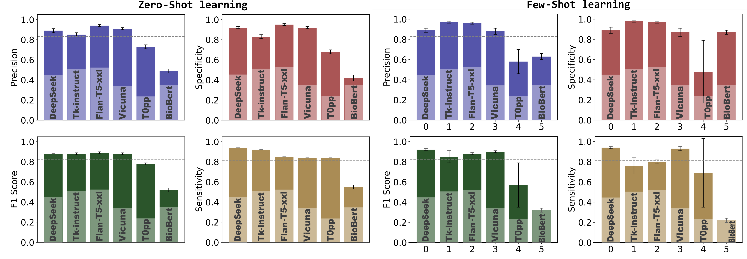
2. Model Evaluation
Validate LLMs performance by identifying PK-DDI sentences
Zero / Few-shot learning evaluated by 10242 (PK and Non-Pk DDI) sentences
Fine-tuned BioBERT

Slide 14
2. Patients’ intrinsic Factors
Evaluate LLM performance on a new task
Prior study
“Because substances in grapefruit juice may inhibit the metabolism of Pimozide by CYP3A4, patients should be advised to avoid grapefruit juice.” [1]
Object?
Grapefruit juice is precipitant and Pimozide is the object drug
“Verapamil therapy may increase serum levels of cyclosporine.” [1]
Verapamil is precipitant and Cyclosporine is the object drug
Precipitant?
2nd Task: Identifying intrinsic factors, such as age, gender, genetics, additional disease and organ function, that may alter clinical exposure
“Following a single 20mg oral Zolpidem tartrate dose, mean Cmax and AUC were found to be two times and five times higher, respectively, in hepatically-compromised patients.” [1]
Zolpidem's clinical exposure have been impacted by Intrinsic factors of liver diseases.
Intrinsic factors?
[1] https://dailymed.nlm.nih.gov/dailymed/fda

Slide 15
2. Prompt Intrinsic factors affecting drug clinical exposure
Model | Task 2: Identifying patient’s intrinsic factors altering drugs’ clinical exposure sentences
Deep Seek | Is it true that the given sentence relates exclusively to the drug’s pharmacokinetics as altered by patients’ intrinsic factors, such as gender, age, weight, genetics, organ’s function, additional diseases, and so forth? Given sentence: ’Levetiracetam Cmax and AUC were 20% higher in women (N = 11) compared to men (N = 12)’. Exclusively answer with Yes or No
Flan-T5 | Is it true that the given sentence relates exclusively to the drug’s pharmacokinetics as altered by patients’ intrinsic factors, such as gender, age, weight, genetics, organ’s function, additional diseases, and so forth? Given sentence: ’Levetiracetam Cmax and AUC were 20% higher in women (N = 11) compared to men (N = 12)’. Options: - Yes - No
Tk-instruct | In this task, you are provided with two sentences. Determine whether the first sentence clearly implies the second sentence. It means the second sentence can be determined only from the first sentence. Provide your answer as either 1 if the first sentence implies the second sentence, or 0 if it does not. Input: Sentence 1: ’Levetiracetam Cmax and AUC were 20% higher in women (N = 11) compared to men (N = 12)’. Sentence 2: The sentence is about pharmacokinetic drug-drug interaction which relates to how the pharmacokinetics of a drug, namely absorption, distribution, metabolism, or excretion, change when co-administered with another drug Output.
T0pp | The following sentence relates to how the pharmacokinetics of a drug, namely absorption, distribution, metabolism, or excretion, change when co-administered with another drug, indicating pharmacokinetic drug-drug interaction. ’Levetiracetam Cmax and AUC were 20% higher in women (N = 11) compared to men (N = 12)’. True, or False?
Vicuna | Given ’Levetiracetam Cmax and AUC were 20% higher in women (N = 11) compared to men (N = 12)’. Is it true that this sentence relates exclusively to the drug’s pharmacokinetics as altered by patients’ intrinsic factors, such as gender, age, weight, genetics, organ’s function, additional diseases, and so forth? Exclusively answer with Yes or No.
Performance significantly declines if the task is not clearly and accurately described to the model.
Levetiracetam Cmax and AUC were 20% higher in women (N=11) compared to men (N=12). Is this statement specifically addressing or pertaining to the pharmacokinetic properties associated with intrinsic factors?
Options:
- Yes
- No
[1] https://dailymed.nlm.nih.gov/dailymed/fda

Slide 16
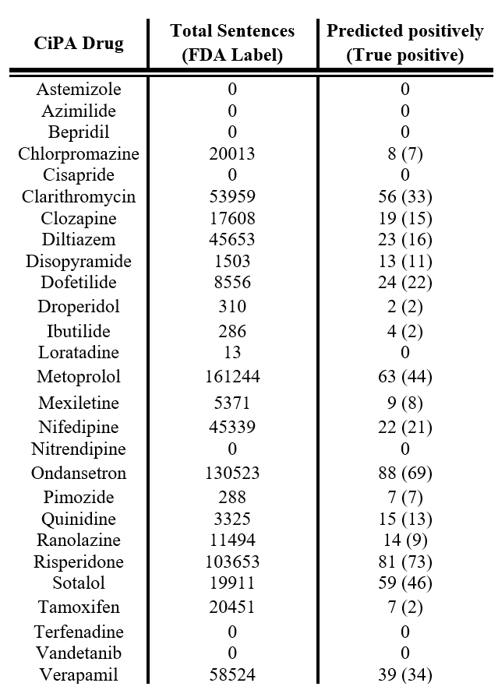
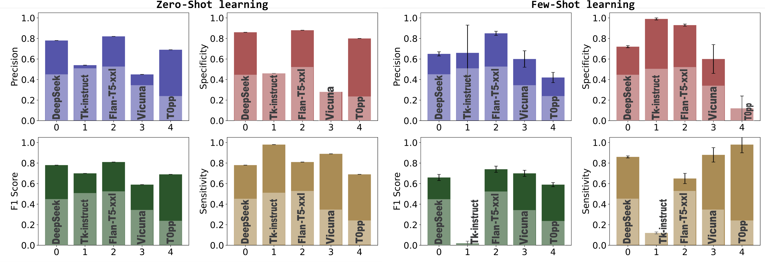
2. Model Evaluation Intrinsic factors affecting drug clinical exposure
Zero and Few-shot learning evaluated by 500 sentences For sentence classification task focused on intrinsic factors that affect drug clinical exposure (198 positive and 302 negative sentences)
From a list of 28 drugs from the Comprehensive in vitro Proarrhythmia Assay (CiPA) Initiative. 708,024 sentences being extracted from the labels
precision rate 78.5%
[1] https://dailymed.nlm.nih.gov/dailymed/fda

Slide 17
2. Question and answer
Flan-T5-XXL
Vicuna-13b-v1.5
T0PP
TK-Instruct

Slide 18
2. Question and answer
DeepSeek (Qwen)
What is pharmacokinetics?
Analysis
What is the difference between pharmacokinetics and pharmacodynamics?
Please reason step by step.
Okay, so I need to figure out what pharmacokinetics is and then understand the difference between pharmacokinetics and pharmacodynamics. Hmm, I remember hearing these terms in my biology class, but I'm a bit fuzzy on the details. Let me try to break it down.
First, pharmacokinetics. I think it has something to do with how drugs move in the body. Maybe it's about absorption, distribution, metabolism, and excretion? Yeah, that sounds familiar. So, when a drug is administered, it gets absorbed into the bloodstream, then distributed throughout the body, metabolized by the liver or other organs, and then excreted, probably through urine or feces. So pharmacokinetics must be the study of these processes. That makes sense because "kinetics" relates to movement or motion, so it's about how the drug moves through the body.
Now, pharmacodynamics. I think this is about what the drug does once it's in the body. Like, how it affects the cells or organs. So it's more about the drug's effects and how it interacts with the body's systems. For example, if a drug is an antibiotic, pharmacodynamics would explain how it kills bacteria. Or if it's a painkiller, how it interacts with the nervous system to relieve pain.
So, putting it together, pharmacokinetics is about the movement and processing of the drug in the body, while pharmacodynamics is about the drug's effects and interactions. They're both important in understanding how medications work and how to use them effectively and safely.
Wait, let me make sure I'm not mixing them up. Sometimes I confuse the two. Pharmacokinetics is the "what happens to the drug in the body," and pharmacodynamics is the "what the drug does to the body." Yeah, that seems right. So, if a doctor wants to determine the right dosage of a medication, they'd look at pharmacokinetics to see how the body absorbs and metabolizes it. Then, they'd look at pharmacodynamics to see the desired effect, like lowering blood pressure or reducing inflammation.
I wonder if there are any overlaps or if they're completely separate fields. I think they're related because the way a drug moves through the body (pharmacokinetics) affects how it can exert its effects (pharmacodynamics). For example, if a drug isn't absorbed properly, it won't reach the necessary concentration to have an effect, which ties into both areas.
Also, I remember something about bioavailability in pharmacokinetics. Bioavailability refers to how much of the drug actually reaches the systemic circulation. If a drug is taken orally, some of it might be metabolized in the liver before it even gets into the bloodstream, which would affect its bioavailability. This is crucial because it determines the effective concentration of the drug in the body.
In pharmacodynamics, concepts like efficacy and potency come into play. Efficacy is the maximum effect a drug can produce, while potency refers to the concentration needed to achieve a certain effect. So, a drug with high efficacy can produce a strong effect, but if it's not potent, you might need a larger dose to reach that effect.
Another thing I'm thinking about is the time course of drug action. Pharmacokinetics deals with how quickly a drug is absorbed and how long it stays in the system, which affects how often it needs to be administered. Pharmacodynamics looks at how quickly the drug starts working and how long the effects last. Together, they help in designing dosing regimens that are both effective and minimize side effects.
I also recall that pharmacokinetics can be influenced by various factors like age, weight, liver and kidney function, and even genetics. For instance, someone with impaired kidney function might excrete drugs more slowly, leading to higher concentrations in the body. This would be a pharmacokinetic consideration. On the other hand, pharmacodynamics can be influenced by factors like tolerance or drug resistance, where the body becomes less responsive to the drug's effects over time.
So, in summary, pharmacokinetics is about the body's handling of the drug—absorption, distribution, metabolism, excretion—while pharmacodynamics is about the drug's handling of the body—its effects and interactions. Understanding both is essential for developing safe and effective medications and determining the appropriate dosages and administration routes.
I think I've got a good grasp now. Pharmacokinetics is the "what happens to the drug," and pharmacodynamics is the "what the drug does." They're two sides of the same coin in pharmacology, each focusing on different aspects of how drugs interact with the body.
**Final Answer**
Pharmacokinetics is the study of how a drug moves through the body, including absorption, distribution, metabolism, and excretion. Pharmacodynamics, on the other hand, focuses on the drug's effects and interactions within the body. The key difference is that pharmacokinetics examines what happens to the drug in the body, while pharmacodynamics examines what the drug does to the body.

Slide 19
Summary
Prior Study
For any task such as identify the clinical exposure, change due to PK DDI from a sentence there are naturally three steps:
Obtain annotated dataset to fine-tune the pre-trained language model.
Identify sentences that carry DDI information in the PK category.
Identify the precipitant and objects drugs in those sentences.
Second Study
Using large language model make it feasible to extract clinical pharmacology information.
We first test it by extracting PK-DDI sentences using four well known LLMs (DeepSeek, Tk-Instruct, Vicuna, T0pp, and Flan-T5-XXL)
Apply a randomly new task (patients' intrinsic factors) without fine-tuning.
Both zero-shot and few-shot learning provided excellent performance.
These models stand out because they don’t require fine-tuning, making them easier to implement compared to the fine-tuned BioBERT model.
Our results demonstrate the feasibility of implementing a ChatGPT-like model within the FDA network with secure local deployment.

Slide 20
Acknowledgment
Zhihua Li
John Mann
Shilpa Chakravartula
Anik Chaturbedi
Fnu Affan
Alexander Galluppi
Nigar Karimil
Ji Young Kim
Yue Han

Slide 21
Thank you!

